Slide 1
0
18
Regulation of Gene Expression

Slide 2
Differential Expression of Genes
Prokaryotes and eukaryotes precisely regulate gene expression in response to environmental conditions
In multicellular eukaryotes, gene expression regulates development and is responsible for differences in cell types
RNA molecules play many roles in regulating gene expression in eukaryotes

Slide 3
Concept 18.1: Bacteria often respond to environmental change by regulating transcription
Natural selection has favored bacteria that produce only the products needed by that cell
A cell can regulate the production of enzymes by feedback inhibition or by gene regulation
One mechanism for control of gene expression in bacteria is the operon model

Slide 4
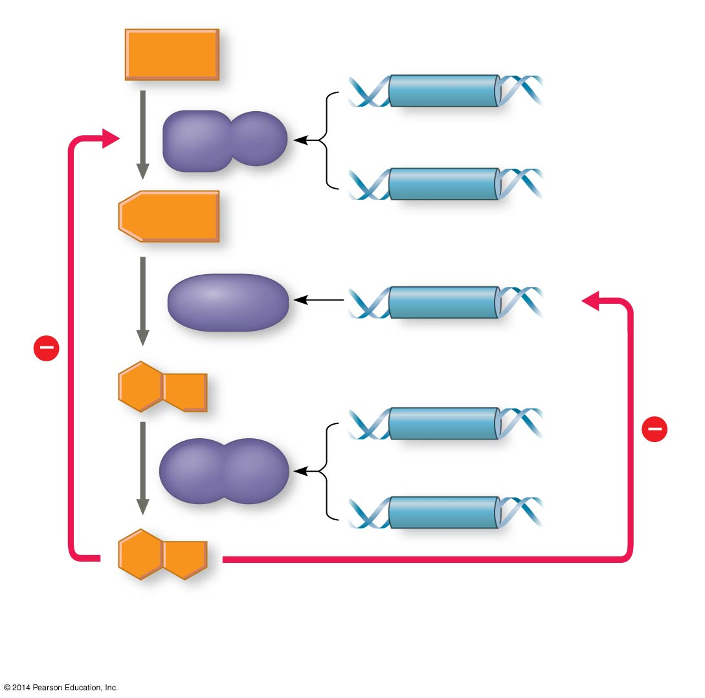
Figure 18.2
Precursor
Feedback inhibition
trpE
Enzyme 1
trpD
Regulation of gene expression
Enzyme 2
trpC
trpB
Enzyme 3
trpA
Tryptophan
(a) Regulation of enzyme activity
(b) Regulation of enzyme production
Notes:
Figure 18.2 Regulation of a metabolic pathway

Slide 5
Operons: The Basic Concept
A cluster of functionally related genes can be coordinately controlled by a single “on-off switch”
The “switch” is a segment of DNA called an operator usually positioned within the promoter
An operon is the entire stretch of DNA that includes the operator, the promoter, and the genes that they control

Slide 6
The operon can be switched off by a protein repressor
The repressor prevents gene transcription by binding to the operator and blocking RNA polymerase
The repressor is the product of a separate regulatory gene

Slide 7
The repressor can be in an active or inactive form, depending on the presence of other molecules

Slide 8
The lac operon is an inducible operon and contains genes that code for enzymes used in the hydrolysis and metabolism of lactose
By itself, the lac repressor is active and switches the lac operon off
A molecule called an inducer inactivates the repressor to turn the lac operon on

Slide 9
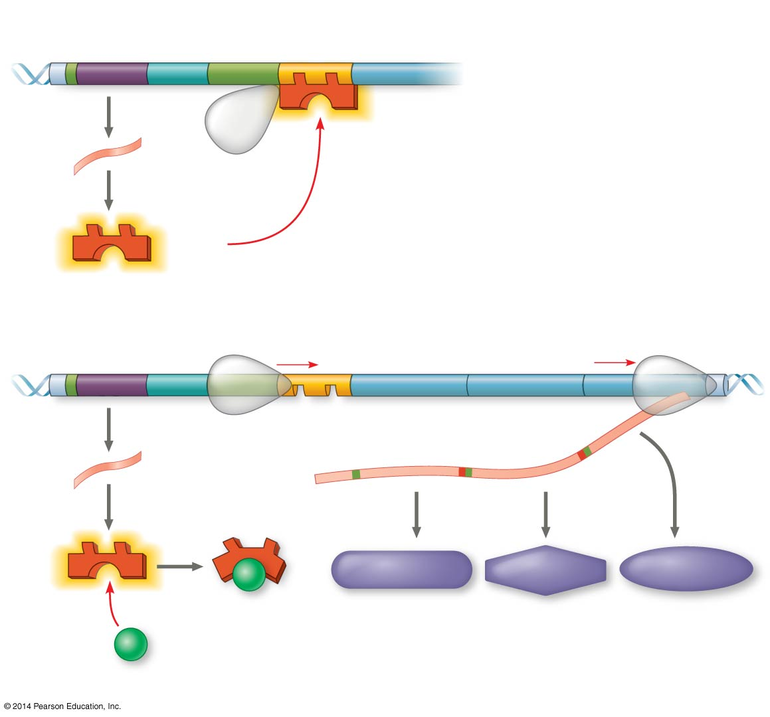
Figure 18.4
Regulatory gene
Promoter
DNA
Operator
lac
I
IacZ
No RNA made
mRNA
3′
5′
RNA polymerase
Protein
Active repressor
(a) Lactose absent, repressor active, operon off
lac operon
DNA
lac
I
lacZ
lacY
lacA
RNA polymerase
Start codon
Stop codon
3′
mRNA
3′
5′
mRNA 5′
Protein
β-Galactosidase
Permease
Transacetylase
Inactive repressor
Allolactose (inducer)
(b) Lactose present, repressor inactive, operon on
Notes:
Figure 18.4 The lac operon in E. coli: regulated synthesis of inducible enzymes

Slide 10
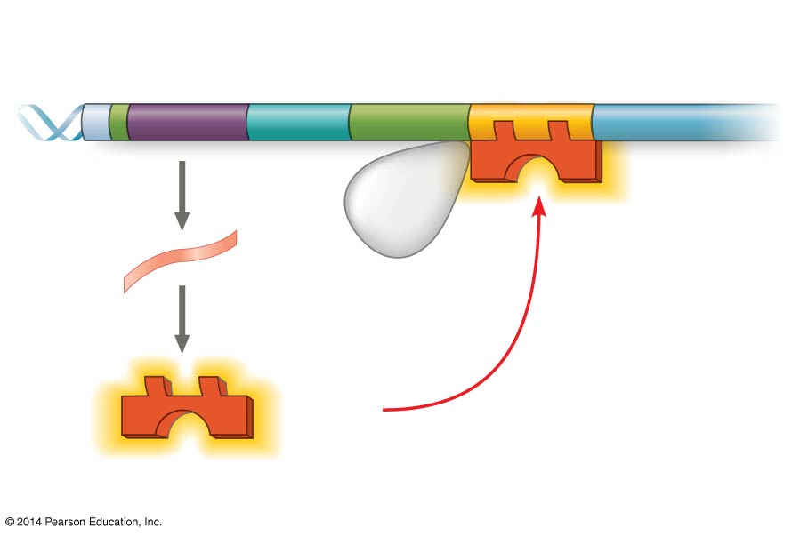
Figure 18.4a
Regulatory gene
Promoter
DNA
Operator
I
lac
IacZ
No RNA made
3′
mRNA
5′
RNA polymerase
Protein
Active repressor
(a) Lactose absent, repressor active, operon off
Notes:
Figure 18.4a The lac operon in E. coli: regulated synthesis of inducible enzymes (part 1: lactose absent)

Slide 11
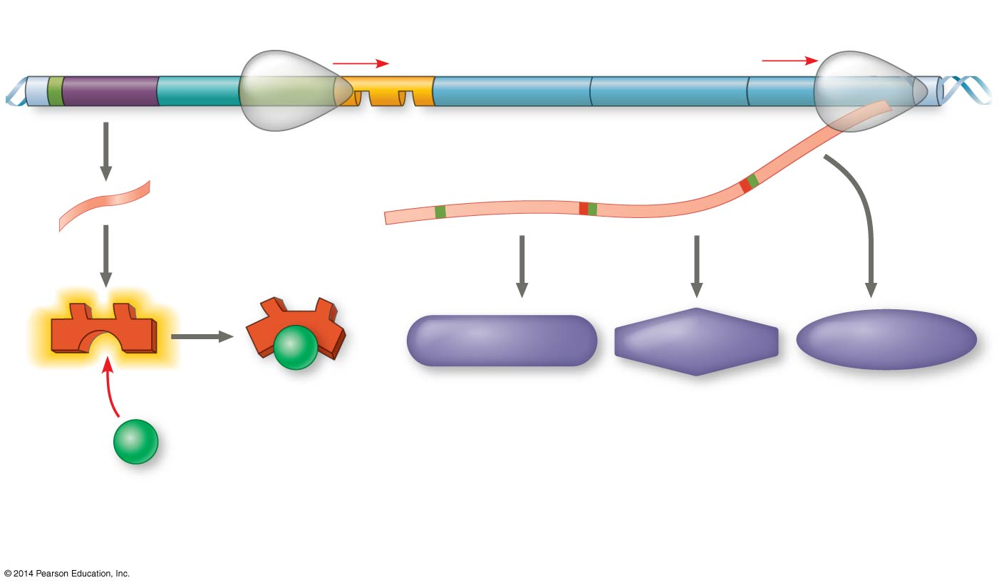
Figure 18.4b
DNA
lac operon
lac
I
lacZ
lacY
lacA
mRNA
RNA polymerase
3′
Start codon
Stop codon
5′
mRNA 5′
Protein
β-Galactosidase
Permease
Transacetylase
Inactive repressor
Allolactose (inducer)
(b) Lactose present, repressor inactive, operon on
Notes:
Figure 18.4b The lac operon in E. coli: regulated synthesis of inducible enzymes (part 2: lactose present)

Slide 12
Inducible enzymes usually function in catabolic pathways; their synthesis is induced by a chemical signal

Slide 13
Positive Gene Regulation
Some operons are also subject to positive control through a stimulatory protein, such as catabolite activator protein (CAP), an activator of transcription
When glucose (a preferred food source of E. coli) is scarce, CAP is activated by binding with cyclic AMP (cAMP)
Activated CAP attaches to the promoter of the lac operon and increases the affinity of RNA polymerase, thus accelerating transcription

Slide 14
When glucose levels increase, CAP detaches from the lac operon, and transcription returns to a normal rate
CAP helps regulate other operons that encode enzymes used in catabolic pathways

Slide 15
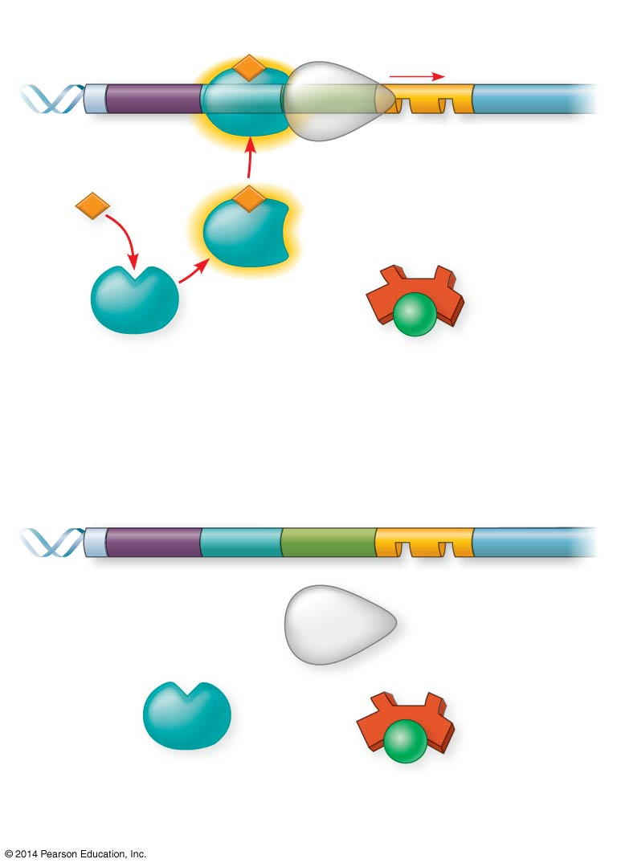
Figure 18.5
Promoter
DNA
Operator
lac
I
lacZ
CAP-binding site
RNA polymerase binds and transcribes
Active
CAP
cAMP
Inactive lac repressor
Inactive
CAP
Allolactose
(a) Lactose present, glucose scarce (cAMP level high): abundant lac mRNA synthesized
Promoter
DNA
lac
I
lacZ
CAP-binding site
Operator
RNA polymerase less likely to bind
Inactive
CAP
Inactive lac repressor
(b) Lactose present, glucose present (cAMP level low): little lac mRNA synthesized
Notes:
Figure 18.5 Positive control of the lac operon by catabolite activator protein (CAP)

Slide 16
Concept 18.2: Eukaryotic gene expression is regulated at many stages
All organisms must regulate which genes are expressed at any given time
In multicellular organisms regulation of gene expression is essential for cell specialization

Slide 17
Differential Gene Expression
Almost all the cells in an organism are genetically identical
Differences between cell types result from differential gene expression, the expression of different genes by cells with the same genome
Abnormalities in gene expression can lead to diseases including cancer
Gene expression is regulated at many stages

Slide 18
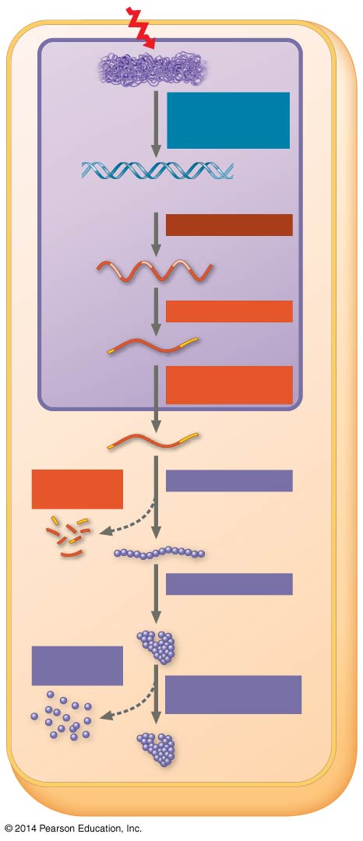
Figure 18.6
Signal
Chromatin
Chromatin modification: DNA unpacking
DNA
Gene available for transcription
Transcription
RNA
Exon
Primary transcript
Intron
RNA processing
Tail
Cap
mRNA in nucleus
NUCLEUS
Transport to cytoplasm
CYTOPLASM
mRNA in cytoplasm
Degradation of mRNA
Translation
Polypeptide
Protein processing
Degradation of protein
Active protein
Transport to cellular destination
Cellular function (such as enzymatic activity or structural support)
Notes:
Figure 18.6 Stages in gene expression that can be regulated in eukaryotic cells

Slide 19
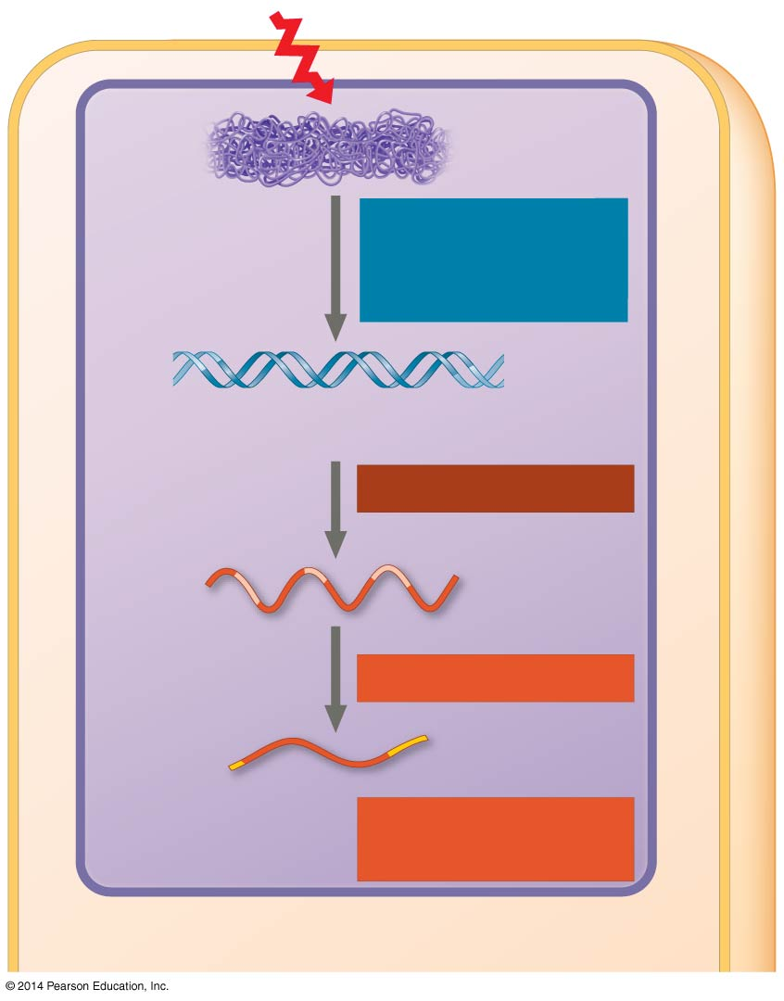
Figure 18.6a
Signal
Chromatin
Chromatin modification: DNA unpacking
DNA
Gene available for transcription
Transcription
RNA
Exon
Primary transcript
Intron
RNA processing
Tail
Cap
mRNA in nucleus
Transport to cytoplasm
NUCLEUS
CYTOPLASM
Notes:
Figure 18.6a Stages in gene expression that can be regulated in eukaryotic cells (part 1: nucleus)

Slide 20
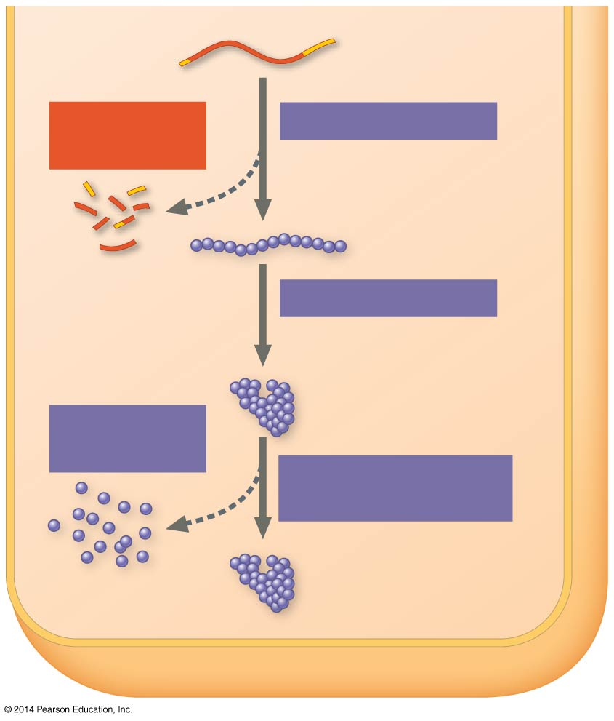
Figure 18.6b
CYTOPLASM
mRNA in cytoplasm
Degradation of mRNA
Translation
Polypeptide
Protein processing
Active protein
Degradation of protein
Transport to cellular destination
Cellular function (such as enzymatic activity or structural support)
Notes:
Figure 18.6b Stages in gene expression that can be regulated in eukaryotic cells (part 2: cytoplasm)

Slide 21
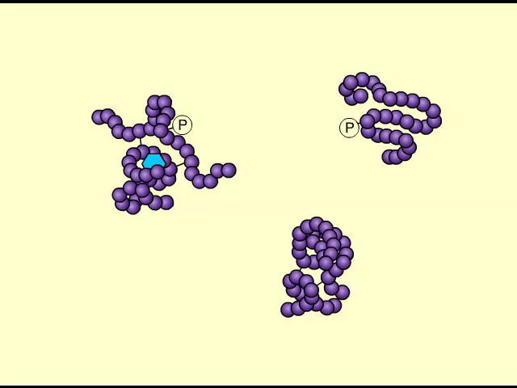
Animation: Protein Degradation

Slide 22
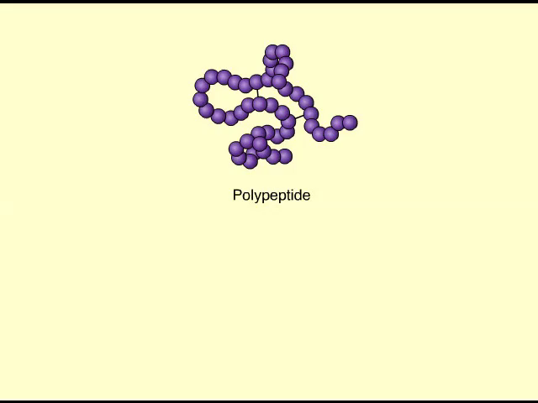
Animation: Protein Processing

Slide 23
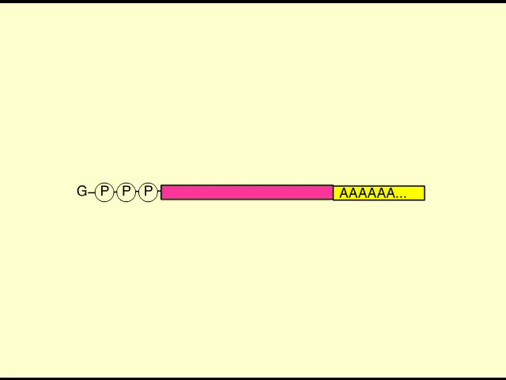
Animation: Blocking Translation

Slide 24
Regulation of Chromatin Structure
The structural organization of chromatin helps regulate gene expression in several ways
Genes within highly packed heterochromatin are usually not expressed
Chemical modifications to histones and DNA of chromatin influence both chromatin structure and gene expression

Slide 25
Histone Modifications and DNA Methylation
In histone acetylation, acetyl groups are attached to positively charged lysines in histone tails
This loosens chromatin structure, thereby promoting the initiation of transcription
The addition of methyl groups (methylation) can condense chromatin; the addition of phosphate groups (phosphorylation) next to a methylated amino acid can loosen chromatin

Slide 26
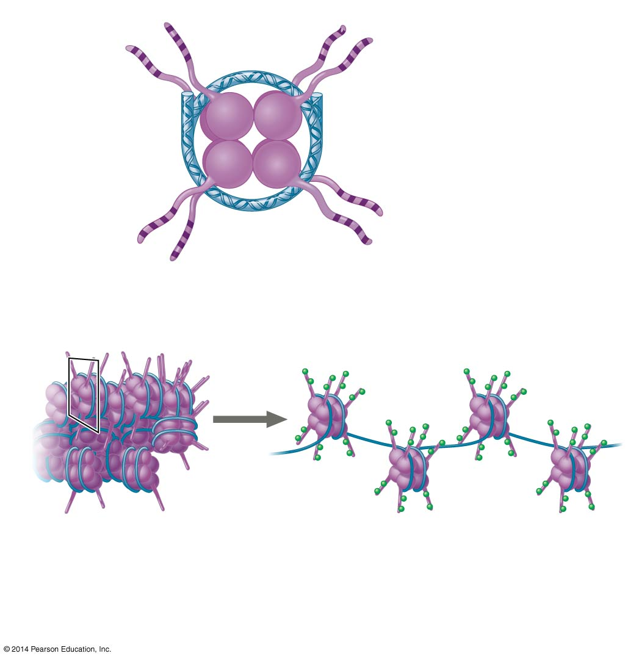
Figure 18.7
Histone tails
DNA double helix
Amino acids available for chemical modification
Nucleosome (end view)
(a) Histone tails protrude outward from a nucleosome
Acetyl groups
DNA
Unacetylated histones (side view)
Acetylated histones
(b) Acetylation of histone tails promotes loose chromatin structure that permits transcription
Notes:
Figure 18.7 A simple model of histone tails and the effect of histone acetylation

Slide 27
DNA methylation, the addition of methyl groups to certain bases in DNA, is associated with reduced transcription in some species
DNA methylation can cause long-term inactivation of genes in cellular differentiation
In genomic imprinting, methylation regulates expression of either the maternal or paternal alleles of certain genes at the start of development

Slide 28
Epigenetic Inheritance
Although the chromatin modifications just discussed do not alter DNA sequence, they may be passed to future generations of cells
The inheritance of traits transmitted by mechanisms not directly involving the nucleotide sequence is called epigenetic inheritance

Slide 29
Regulation of Transcription Initiation
Chromatin-modifying enzymes provide initial control of gene expression by making a region of DNA either more or less able to bind the transcription machinery

Slide 30
Organization of a Typical Eukaryotic Gene
Associated with most eukaryotic genes are multiple control elements, segments of noncoding DNA that serve as binding sites for transcription factors that help regulate transcription
Control elements and the transcription factors they bind are critical to the precise regulation of gene expression in different cell types

Slide 31
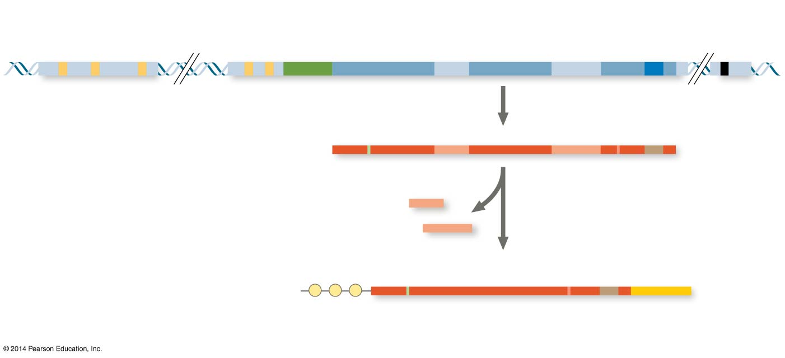
Figure 18.8
Enhancer (group of distal control elements)
Proximal control elements
Transcription start site
Poly-A signal sequence
Transcription termination region
DNA
Exon
Intron
Exon
Intron
Exon
Upstream
Promoter
Downstream
Transcription
Poly-A signal
Primary RNA transcript (pre-mRNA)
Exon
Intron
Exon
Intron
Exon
Cleaved 3′ end of primary transcript
5′
Intron RNA
RNA processing
Coding segment
mRNA
G P P P
AAA⋯AAA
3′
5′ Cap
5′ UTR
Start codon
Stop codon
3′ UTR
Poly-A tail
Notes:
Figure 18.8 A eukaryotic gene and its transcript

Slide 32
The Roles of Transcription Factors
To initiate transcription, eukaryotic RNA polymerase requires the assistance of transcription factors
General transcription factors are essential for the transcription of all protein-coding genes
In eukaryotes, high levels of transcription of particular genes depend on control elements interacting with specific transcription factors

Slide 33
Enhancers and Specific Transcription Factors
Proximal control elements are located close to the promoter
Distal control elements, groupings of which are called enhancers, may be far away from a gene or even located in an intron

Slide 34
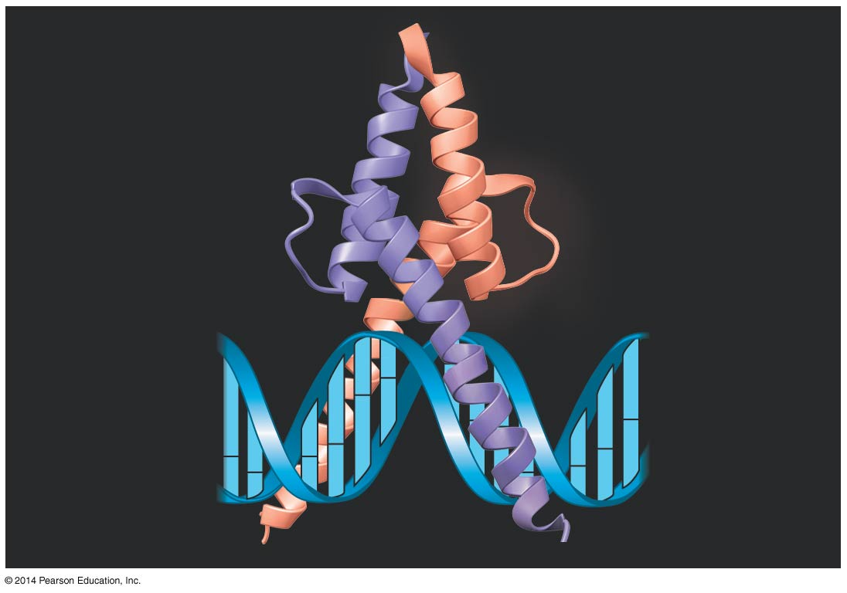
Figure 18.9
Activation domain
DNA-binding domain
DNA
Notes:
Figure 18.9 The structure of MyoD, an activator

Slide 35
An activator is a protein that binds to an enhancer and stimulates transcription of a gene
Activators have two domains, one that binds DNA and a second that activates transcription
Bound activators facilitate a sequence of protein-protein interactions that result in transcription of a given gene

Slide 36

Figure 18.10-1
DNA
Activators
Promoter
Gene
Enhancer
Distal control element
TATA box
Notes:
Figure 18.10-1 A model for the action of enhancers and transcription activators (step 1)

Slide 37
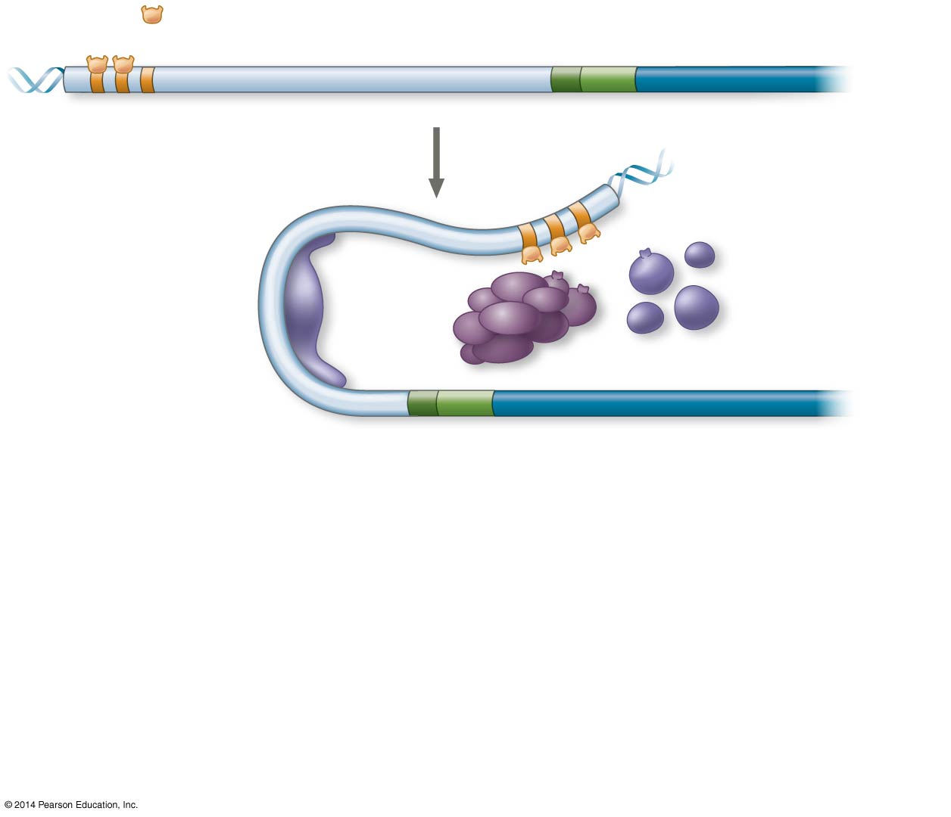
Figure 18.10-2
DNA
Activators
Promoter
Gene
Enhancer
Distal control element
TATA box
General transcription factors
DNA- bending protein
Group of mediator proteins
Notes:
Figure 18.10-2 A model for the action of enhancers and transcription activators (step 2)

Slide 38
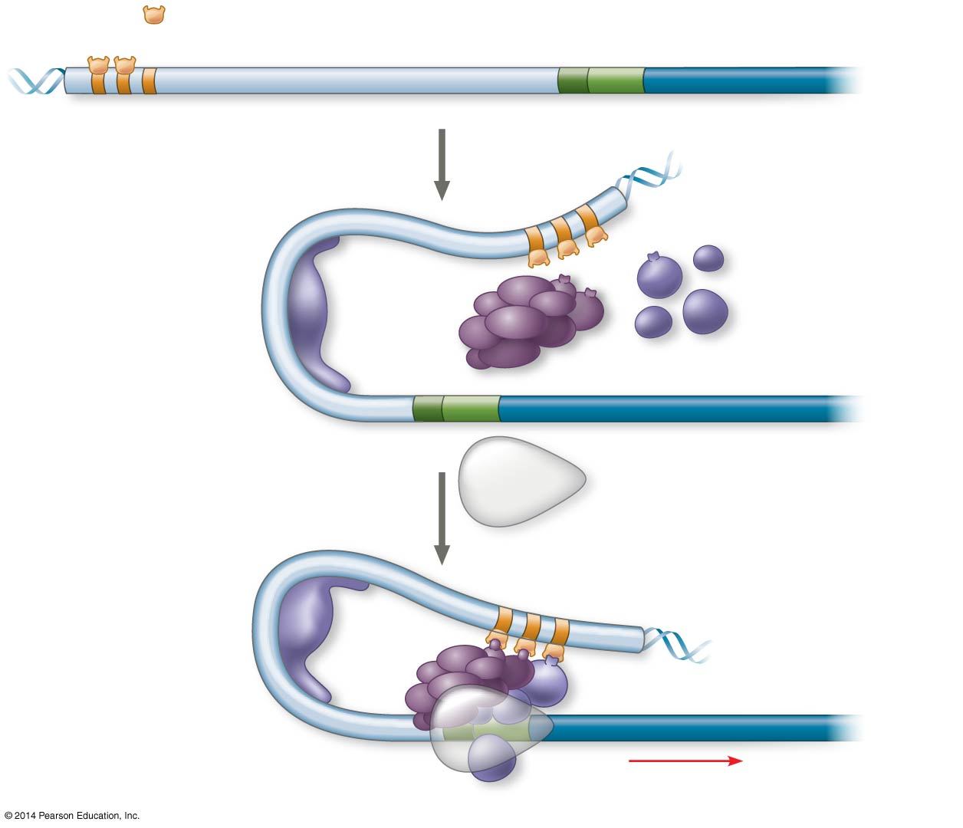
Figure 18.10-3
DNA
Activators
Promoter
Gene
Enhancer
Distal control element
TATA box
General transcription factors
DNA- bending protein
Group of mediator proteins
RNA polymerase II
RNA polymerase II
Transcription initiation complex
RNA synthesis
Notes:
Figure 18.10-3 A model for the action of enhancers and transcription activators (step 3)

Slide 39
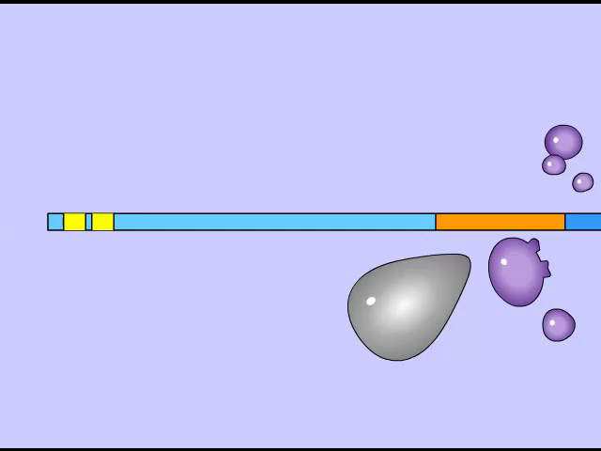
Animation: Initiation of Transcription

Slide 40
Some transcription factors function as repressors, inhibiting expression of a particular gene by a variety of methods
Some activators and repressors act indirectly by influencing chromatin structure to promote or silence transcription

Slide 41
Combinatorial Control of Gene Activation
A particular combination of control elements can activate transcription only when the appropriate activator proteins are present

Slide 42
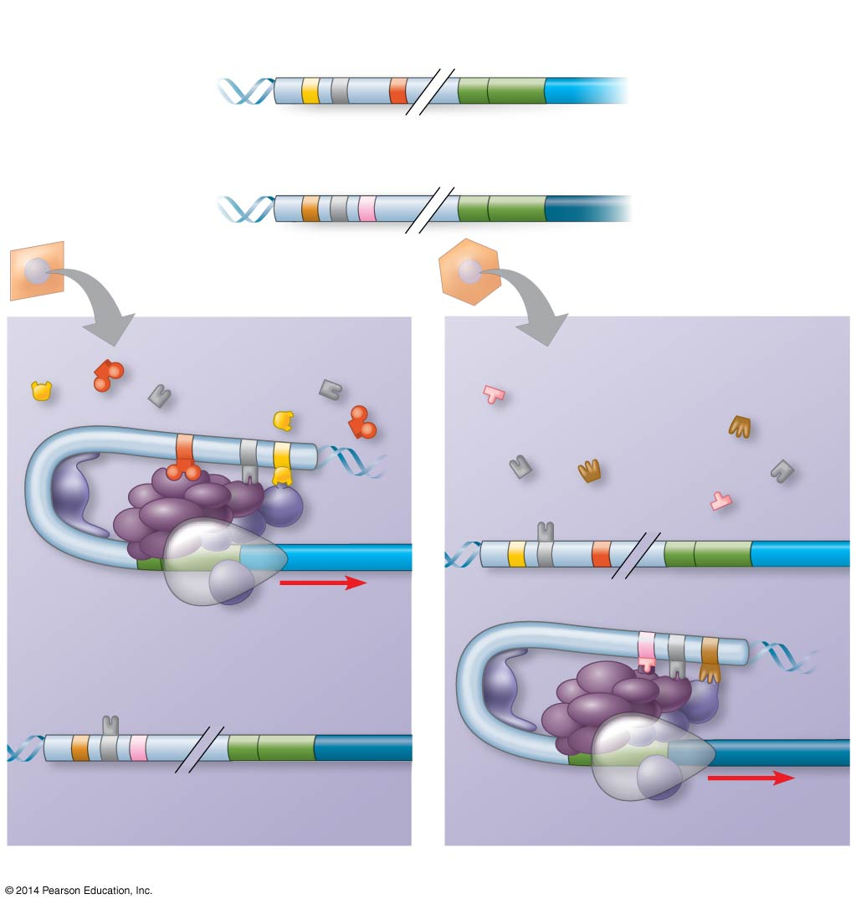
Figure 18.11
DNA in both cells contains the albumin gene and the crystallin gene:
Enhancer for albumin gene
Promoter
Albumin gene
Control elements
Enhancer for crystallin gene
Promoter
Crystallin gene
LIVER CELL NUCLEUS
LENS CELL NUCLEUS
Available activators
Available activators
Albumin gene not expressed
Albumin gene expressed
Crystallin gene not expressed
Crystallin gene expressed
(a) Liver cell
(b) Lens cell
Notes:
Figure 18.11 Cell type–specific transcription

Slide 43
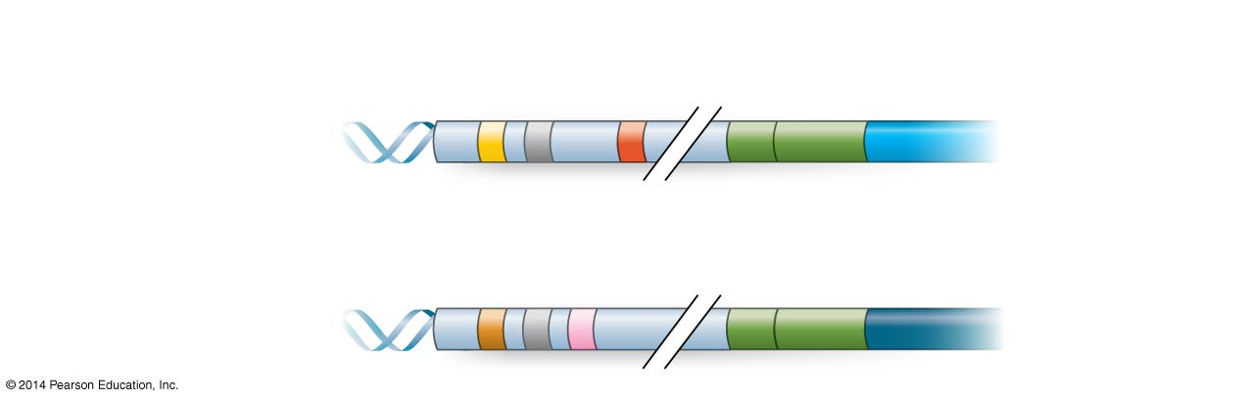
Figure 18.11a
DNA in both cells contains the albumin gene and the crystallin gene:
Enhancer for albumin gene
Promoter
Albumin gene
Control elements
Enhancer for crystallin gene
Promoter
Crystallin gene
Notes:
Figure 18.11a Cell type–specific transcription (part 1: DNA)

Slide 44
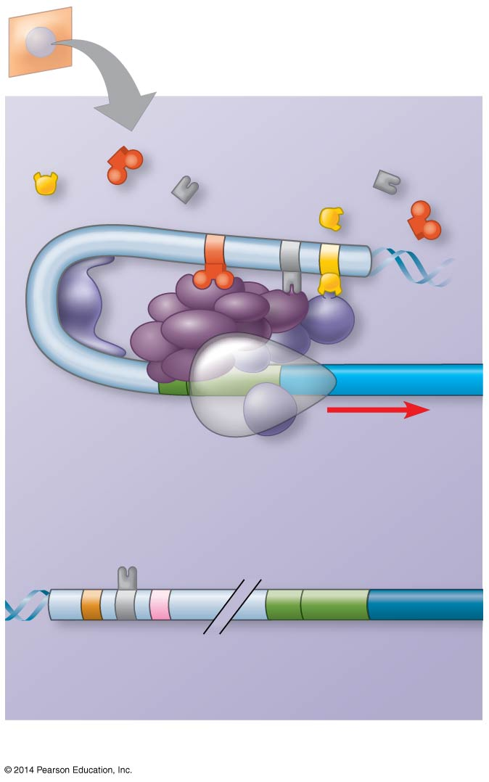
Figure 18.11b
LIVER CELL NUCLEUS
Available activators
Albumin gene expressed
Crystallin gene not expressed
(a) Liver cell
Notes:
Figure 18.11b Cell type–specific transcription (part 2: liver cell nucleus)

Slide 45
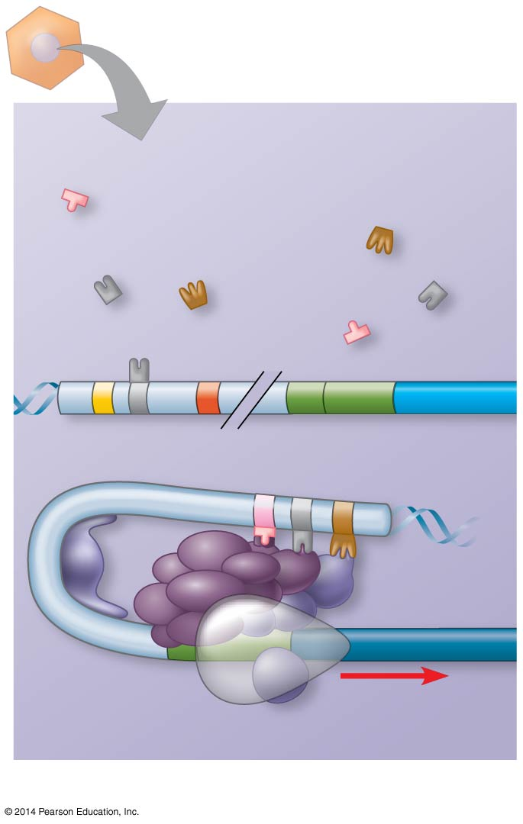
Figure 18.11c
LENS CELL NUCLEUS
Available activators
Albumin gene not expressed
Crystallin gene expressed
(b) Lens cell
Notes:
Figure 18.11c Cell type–specific transcription (part 3: lens cell nucleus)

Slide 46
Coordinately Controlled Genes in Eukaryotes
Co-expressed eukaryotic genes are not organized in operons (with a few minor exceptions)
These genes can be scattered over different chromosomes, but each has the same combination of control elements
Copies of the activators recognize specific control elements and promote simultaneous transcription of the genes

Slide 47
Nuclear Architecture and Gene Expression
Loops of chromatin extend from individual chromosome territories into specific sites in the nucleus
Loops from different chromosomes may congregate at particular sites, some of which are rich in transcription factors and RNA polymerases
These may be areas specialized for a common function

Slide 48
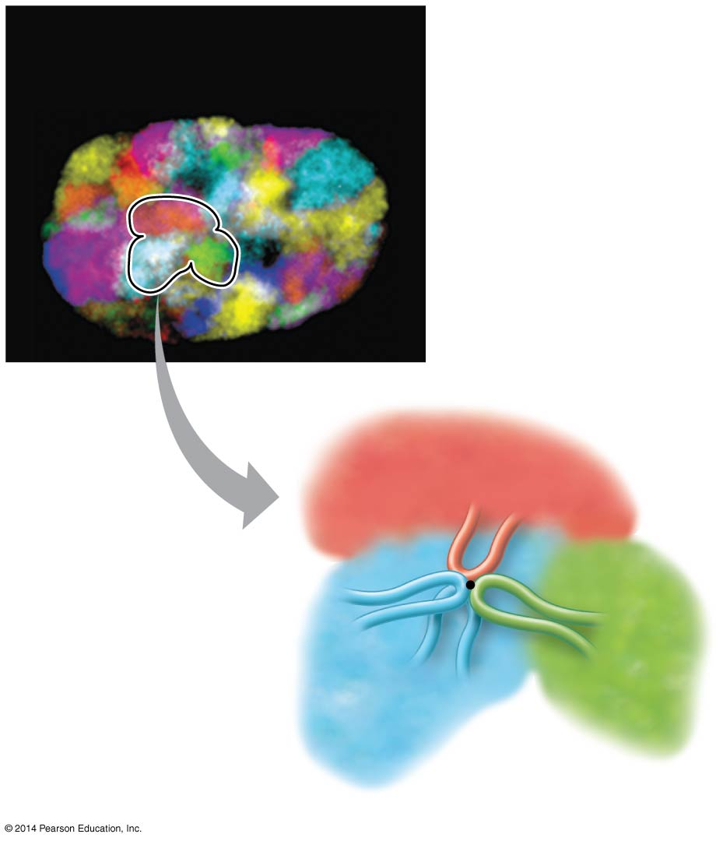
Figure 18.12
Chromosomes in the interphase nucleus (fluorescence micrograph)
Chromosome territory
5 µm
Chromatin loop
Transcription factory
Notes:
Figure 18.12 Chromosomal interactions in the interphase nucleus

Slide 49
Mechanisms of Post-Transcriptional Regulation
Transcription alone does not account for gene expression
Regulatory mechanisms can operate at various stages after transcription
Such mechanisms allow a cell to fine-tune gene expression rapidly in response to environmental changes

Slide 50
RNA Processing
In alternative RNA splicing, different mRNA molecules are produced from the same primary transcript, depending on which RNA segments are treated as exons and which as introns

Slide 51
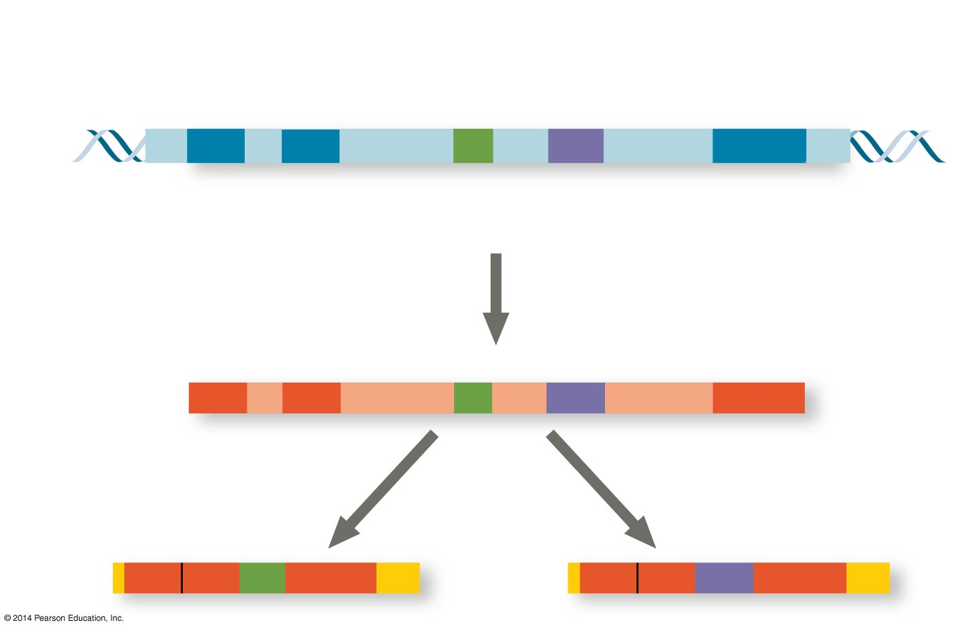
Figure 18.13
Exons
DNA
1 2 3 4 5
Troponin T gene
Primary RNA transcript
1 2 3 4 5
RNA splicing
mRNA
1 2 3 5
OR
1 2 4 5
Notes:
Figure 18.13 Alternative RNA splicing of the troponin T gene

Slide 52
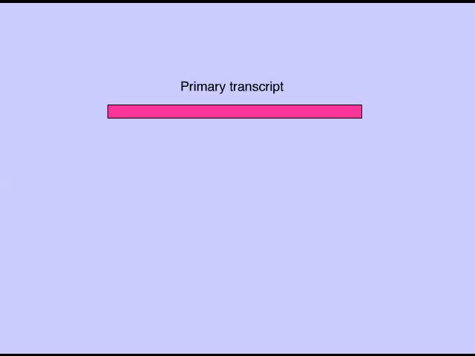
Animation: RNA Processing

Slide 53
Initiation of Translation and mRNA Degradation
The initiation of translation of selected mRNAs can be blocked by regulatory proteins that bind to sequences or structures of the mRNA
Alternatively, translation of all mRNAs in a cell may be regulated simultaneously
For example, translation initiation factors are simultaneously activated in an egg following fertilization

Slide 54
The life span of mRNA molecules in the cytoplasm is a key to determining protein synthesis
Eukaryotic mRNA is more long lived than prokaryotic mRNA
Nucleotide sequences that influence the lifespan of mRNA in eukaryotes reside in the untranslated region (UTR) at the 3′ end of the molecule

Slide 55
Protein Processing and Degradation
After translation, various types of protein processing, including cleavage and the addition of chemical groups, are subject to control
The length of time each protein function is regulated by selective degradation
Cells mark proteins for degradation by attaching ubiquitin to them
This mark is recognized by proteasomes, which recognize and degrade the proteins

Slide 56
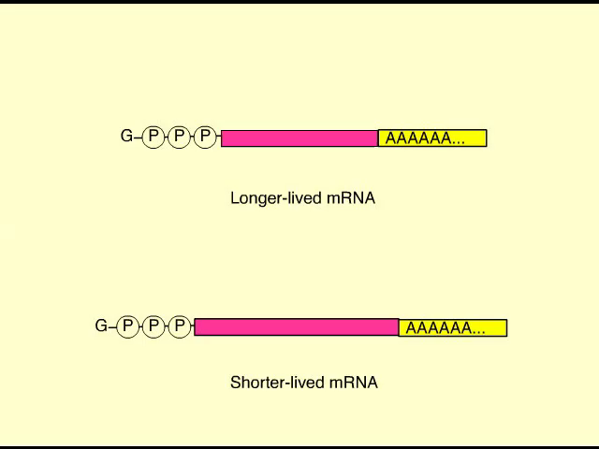
Animation: mRNA Degradation

Slide 57
Concept 18.3: Noncoding RNAs play multiple roles in controlling gene expression
Only a small fraction of DNA codes for proteins, and a very small fraction of the non-protein-coding DNA consists of genes for RNA such as rRNA and tRNA
A significant amount of the genome may be transcribed into noncoding RNAs (ncRNAs)
Noncoding RNAs regulate gene expression at two points: mRNA translation and chromatin configuration

Slide 58
Effects on mRNAs by MicroRNAs and Small Interfering RNAs
MicroRNAs (miRNAs) are small single-stranded RNA molecules that can bind to mRNA
These can degrade mRNA or block its translation
It is estimated that expression of at least half of all human genes may be regulated by miRNAs

Slide 59
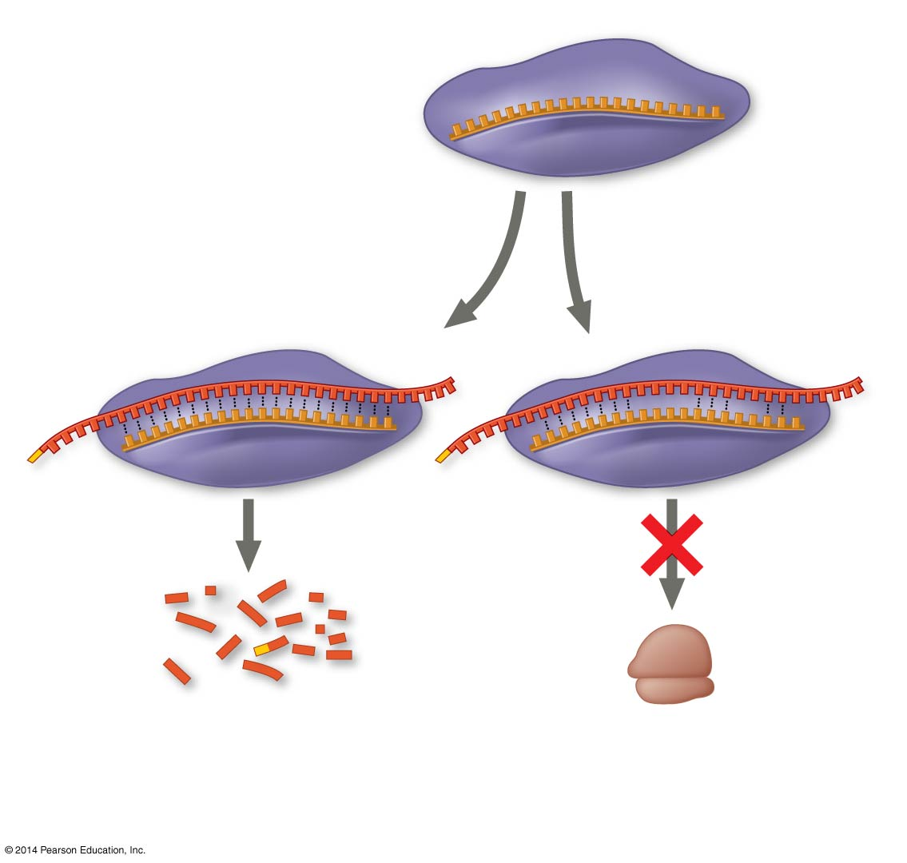
Figure 18.14
miRNA
miRNA- protein complex
1
The miRNA binds to a target mRNA.
OR
mRNA degraded
Translation blocked
2
If bases are completely complementary, mRNA is degraded. If match is less than complete, translation is blocked.
Notes:
Figure 18.14 Regulation of gene expression by miRNAs

Slide 60
Small interfering RNAs (siRNAs) are similar to miRNAs in size and function
The blocking of gene expression by siRNAs is called RNA interference (RNAi)
RNAi is used in the laboratory as a means of disabling genes to investigate their function

Slide 61
Chromatin Remodeling by ncRNAs
Some ncRNAs act to bring about remodeling of chromatin structure
In some yeasts siRNAs re-form heterochromatin at centromeres after chromosome replication

Slide 62
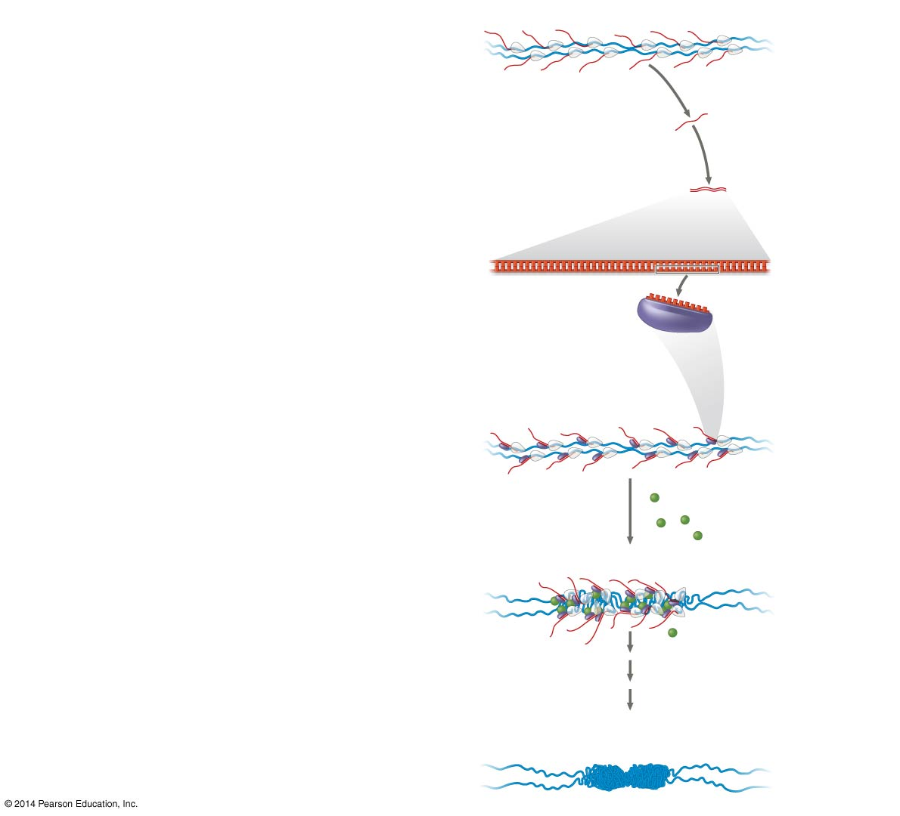
Figure 18.15
Centromeric DNA
1
RNA transcripts (red) produced.
RNA polymerase
Sister chromatids (two DNA molecules)
RNA transcript
2
Yeast enzyme synthesizes strands complementary to RNA transcripts.
3
Double-stranded RNA processed into siRNAs that associate with proteins.
siRNA-protein complex
4
The siRNA-protein complexes bind RNA transcripts and become tethered to centromere region.
5
The siRNA-protein complexes recruit histone-modifying enzymes.
Centromeric DNA
Chromatin- modifying enzymes
6
Chromatin condensation is initiated and heterochromatin is formed.
Heterochromatin at the centromere region
Notes:
Figure 18.15 Condensation of chromatin at the centromere

Slide 63
Small ncRNAs called piwi-associated RNAs (piRNAs) induce heterochromatin, blocking the expression of parasitic DNA elements in the genome, known as transposons
RNA-based regulation of chromatin structure is likely to play an important role in gene regulation

Slide 64
The Evolutionary Significance of Small ncRNAs
Small ncRNAs can regulate gene expression at multiple steps
An increase in the number of miRNAs in a species may have allowed morphological complexity to increase over evolutionary time
siRNAs may have evolved first, followed by miRNAs and later piRNAs

Slide 65
Concept 18.4: A program of differential gene expression leads to the different cell types in a multicellular organism
During embryonic development, a fertilized egg gives rise to many different cell types
Cell types are organized successively into tissues, organs, organ systems, and the whole organism
Gene expression orchestrates the developmental programs of animals

Slide 66
Genetic Analysis of Early Development: Scientific Inquiry
Edward B. Lewis, Christiane Nüsslein-Volhard, and Eric Wieschaus won a Nobel Prize in 1995 for decoding pattern formation in Drosophila
Lewis discovered the homeotic genes, which control pattern formation in late embryo, larva, and adult stages

Slide 67
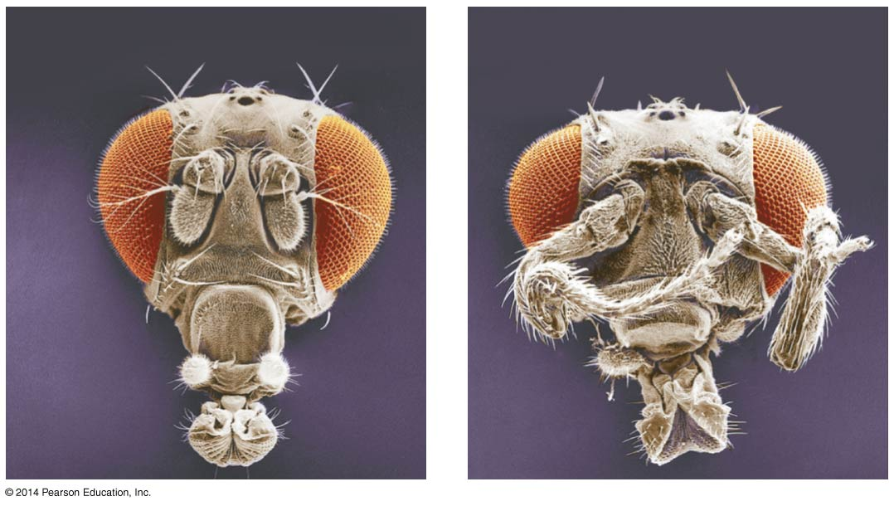
Figure 18.20
Wild type
Mutant
Eye
Antenna
Leg
Notes:
Figure 18.20 Abnormal pattern formation in Drosophila

Slide 68
Nüsslein-Volhard and Wieschaus studied segment formation
They created mutants, conducted breeding experiments, and looked for corresponding genes
Many of the identified mutations were embryonic lethals, causing death during embryogenesis
They found 120 genes essential for normal segmentation

Slide 69
Axis Establishment
Maternal effect genes encode cytoplasmic determinants that initially establish the axes of the body of Drosophila
These maternal effect genes are also called egg-polarity genes because they control orientation of the egg and consequently the fly

Slide 70
Concept 18.5: Cancer results from genetic changes that affect cell cycle control
The gene regulation systems that go wrong during cancer are the very same systems involved in embryonic development

Slide 71
Types of Genes Associated with Cancer
Cancer can be caused by mutations to genes that regulate cell growth and division
Mutations in these genes can be caused by spontaneous mutation or environmental influences such as chemicals, radiation, and some viruses

Slide 72
Oncogenes are cancer-causing genes in some types of viruses
Proto-oncogenes are the corresponding normal cellular genes that are responsible for normal cell growth and division
Conversion of a proto-oncogene to an oncogene can lead to abnormal stimulation of the cell cycle

Slide 73
Proto-oncogenes can be converted to oncogenes by
Movement of DNA within the genome: if it ends up near an active promoter, transcription may increase
Amplification of a proto-oncogene: increases the number of copies of the gene
Point mutations in the proto-oncogene or its control elements: cause an increase in gene expression

Slide 74
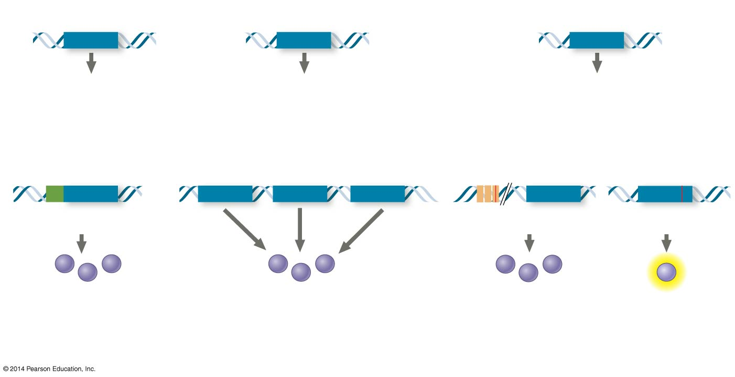
Figure 18.23
Proto-oncogene
Proto-oncogene
Proto-oncogene
Translocation or transposition: gene moved to new locus, under new controls
Gene amplification: multiple copies of the gene
Point mutation:
within a control element
New promoter
within the gene
Oncogene
Oncogene
Oncogene
Normal growth- stimulating protein in excess
Normal growth-stimulating protein in excess
Normal growth- stimulating protein in excess
Hyperactive or degradation- resistant protein
Notes:
Figure 18.23 Genetic changes that can turn proto-oncogenes into oncogenes

Slide 75
Tumor-Suppressor Genes
Tumor-suppressor genes normally help prevent uncontrolled cell growth
Mutations that decrease protein products of tumor-suppressor genes may contribute to cancer onset
Tumor-suppressor proteins
Repair damaged DNA
Control cell adhesion
Act in cell-signaling pathways that inhibit the cell cycle

Slide 76
The Multistep Model of Cancer Development
Multiple mutations are generally needed for full-fledged cancer; thus the incidence increases with age
At the DNA level, a cancerous cell is usually characterized by at least one active oncogene and the mutation of several tumor-suppressor genes

Slide 77
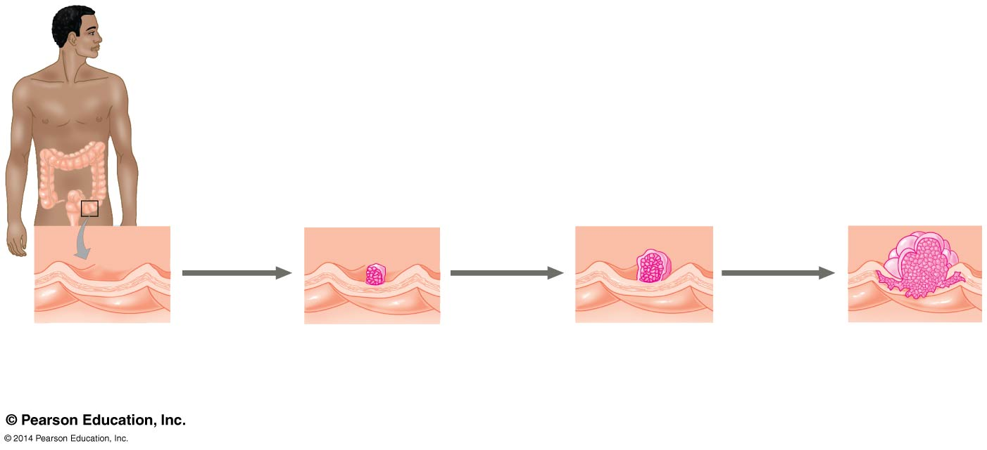
Figure 18.26
Colon
Loss of tumor-suppressor gene p53
1
2
4
Loss of tumor- suppressor gene APC (or other)
Activation of ras oncogene
Colon wall
Normal colon epithelial cells
Small benign growth (polyp)
3
Larger benign growth (adenoma)
5
Malignant tumor (carcinoma)
Loss of tumor- suppressor gene SMAD4
Additional mutations
Notes:
Figure 18.26 A multistep model for the development of colorectal cancer

Slide 78
Routine screening for some cancers, such as colorectal cancer, is recommended
In such cases, any suspicious polyps may be removed before cancer progresses
Breast cancer is a heterogeneous disease that is the commonest form of cancer in women in the United States
A genomics approach to profiling breast tumors has identified four major types of breast cancer

Slide 79
Inherited Predisposition and Environmental Factors Contributing to Cancer
Individuals can inherit oncogenes or mutant alleles of tumor-suppressor genes
Inherited mutations in the tumor-suppressor gene adenomatous polyposis coli are common in individuals with colorectal cancer
Mutations in the BRCA1 or BRCA2 gene are found in at least half of inherited breast cancers, and tests using DNA sequencing can detect these mutations

Slide 80
The Role of Viruses in Cancer
A number of tumor viruses can also cause cancer in humans and animals
Viruses can interfere with normal gene regulation in several ways if they integrate into the DNA of a cell
Viruses are powerful biological agents

Slide 81
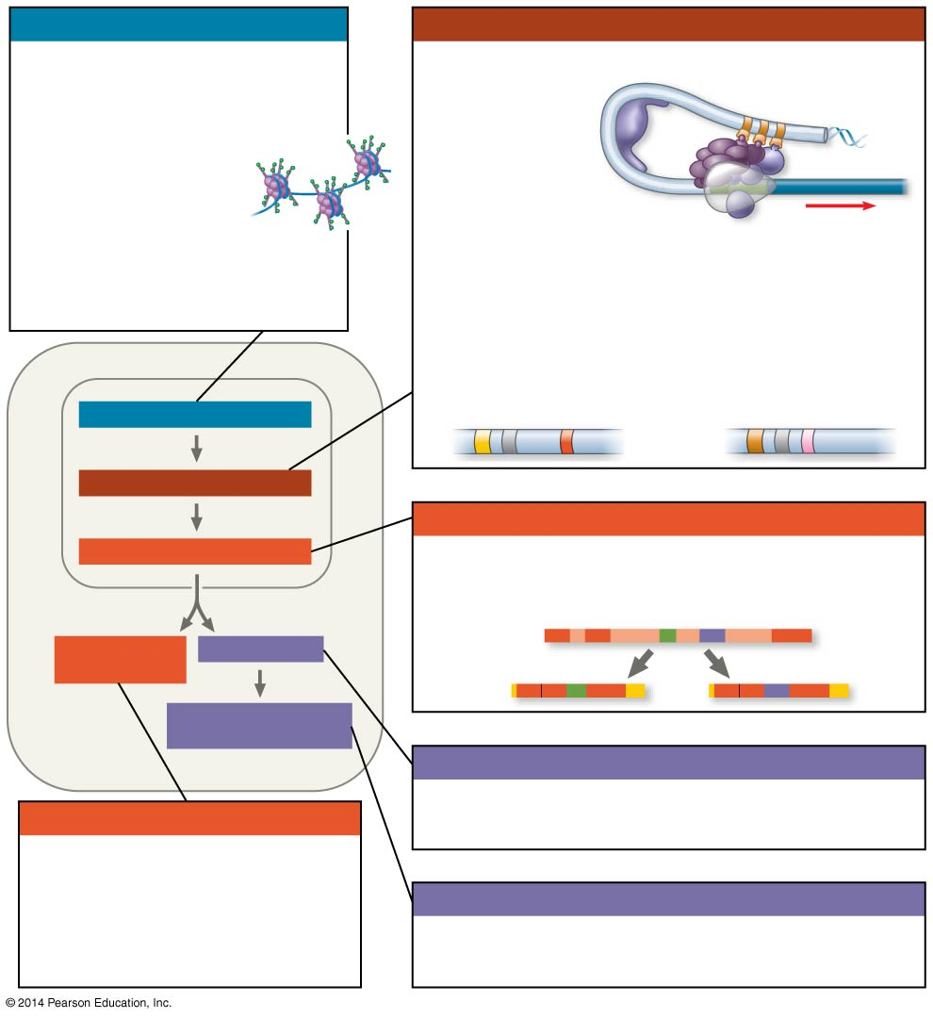
Figure 18.UN09
Chromatin modification
Transcription
• Genes in highly compacted chromatin are generally not transcribed.
• Histone acetylation
seems to loosen
chromatin structure,
enhancing transcription.
• DNA methylation generally
reduces transcripton.
• Regulation of transcription initiation: DNA control elements in enhancers bind specific tran- scription factors. Bending of the DNA enables activators to contact proteins at the promoter, initiating transcription.
• Coordinate regulation:
Enhancer for liver-specific genes
Enhancer for lens-specific genes
CHROMATIN MODIFICATION
TRANSCRIPTION
RNA processing
RNA PROCESSING
• Alternative RNA splicing:
Primary RNA transcript
mRNA DEGRADATION
TRANSLATION
mRNA
OR
PROTEIN PROCESSING AND DEGRADATION
Translation
mRNA degradation
• Initiation of translation can be controlled via regulation of initiation factors.
• Each mRNA has a characteristic life span, determined in part by sequences in the 5′ and 3′ UTRs.
Protein processing and degradation
• Protein processing and degradation are subject to regulation.
Notes:
Figure 18.UN09 Summary of key concepts: eukaryotic regulation of gene expression

